Slide 1
Spatial Database Project (CS621B)
Spatial Analysis of Regime Schools in Bangalore
Student ID : 21250164
Student Name : Anush Harish

Slide 2
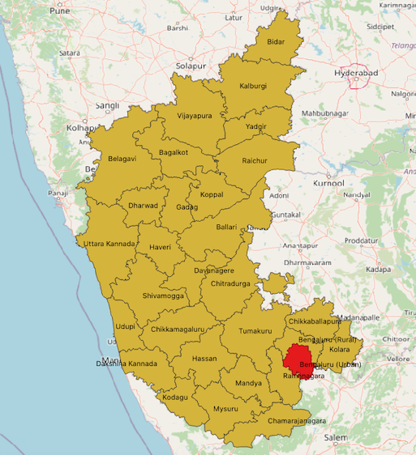
Analysis of Regime Schools in Bangalore
Bangalore(also called Bengaluru) is the capital of India's southern Karnataka state. It is called as Silicon Valley of India.
Bangalore has one of the best educational institutions in India and the standard of education is considered to be very high compared to many other states in the country.

Slide 3
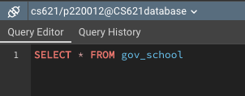
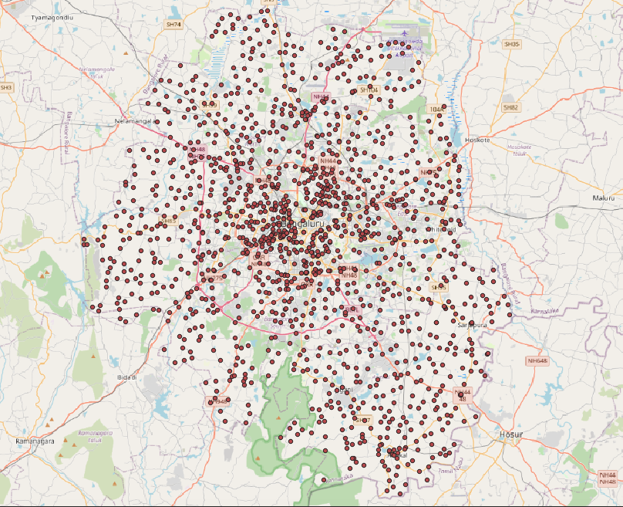
All the Regime schools in Bangalore.
There are 1401 Regime schools in Bangalore.

Slide 4
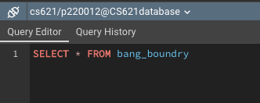
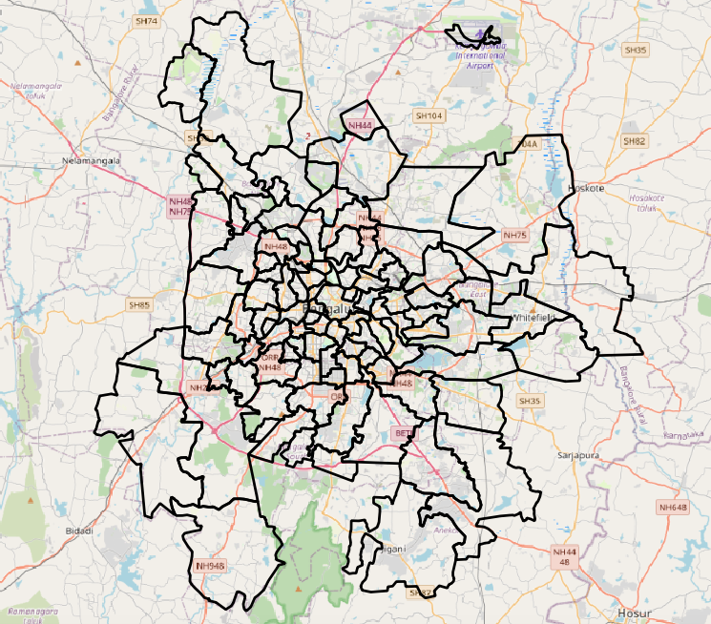
Partitions of Bengaluru Localities by Zip Code.
There are 101 Localities by Zip Code in Bengaluru.

Slide 5
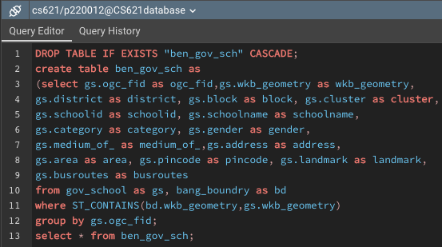
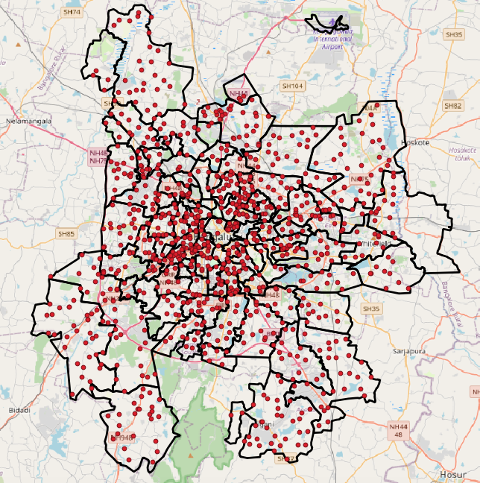
Selecting Regime schools by Localities
There are 954 Regime Schools based on Localities by Zip Code.

Slide 6
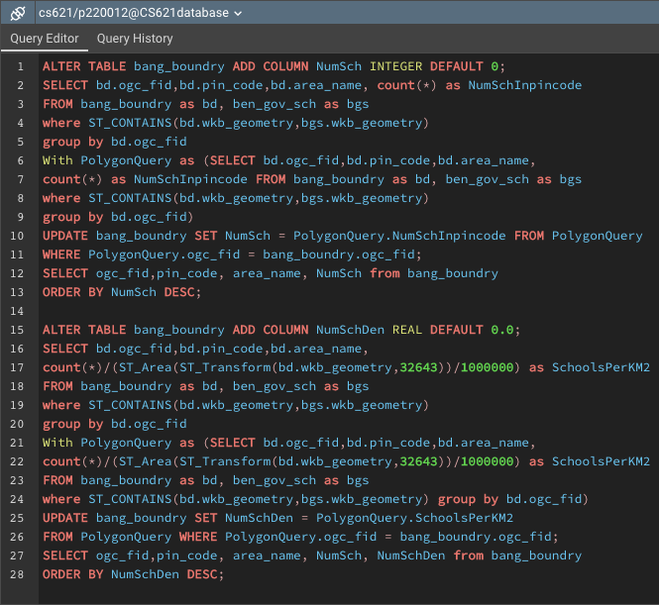
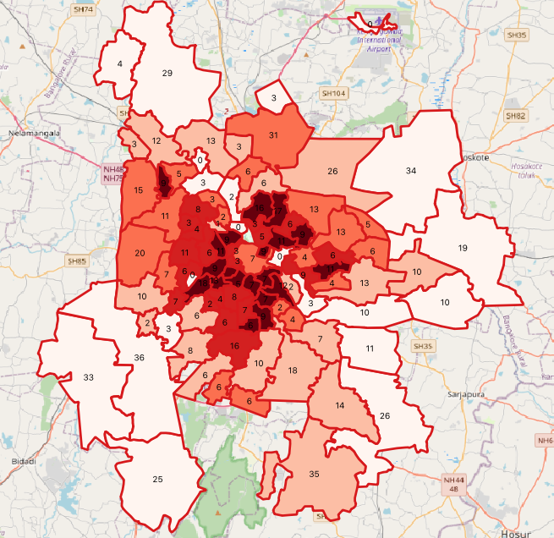
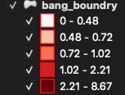
Density based analysis of schools in each localities

Slide 7
Problem Statement
Ram wants to admit his son to a regime school proximate to his residence.
(Ram’s Residence Address : Next to Vijayanagar Post office, 14th Main Road, Marenahalli Ward, Bengaluru - 560040, Karnataka, India).
With the following conditions:
The medium of inculcation should be Kannada.
Schools should have co-education.
The school should have bus facilities to travel.
The school should be proximate to Ram's residence within a radius of 2km.
And Quality of Education should be good.

Slide 8
Stepwise Analysis
Categorize the medium of inculcation and select only the Kannada medium schools.
Filter the schools which have co-education.
Get the WKT points from the provided residence address.
Select the school which has convenient bus facilities.
Select the schools which are within a 2 km radius proximate to Ram’s residence.
Finally, select the school which has more passing percentage.

Slide 9
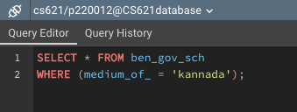
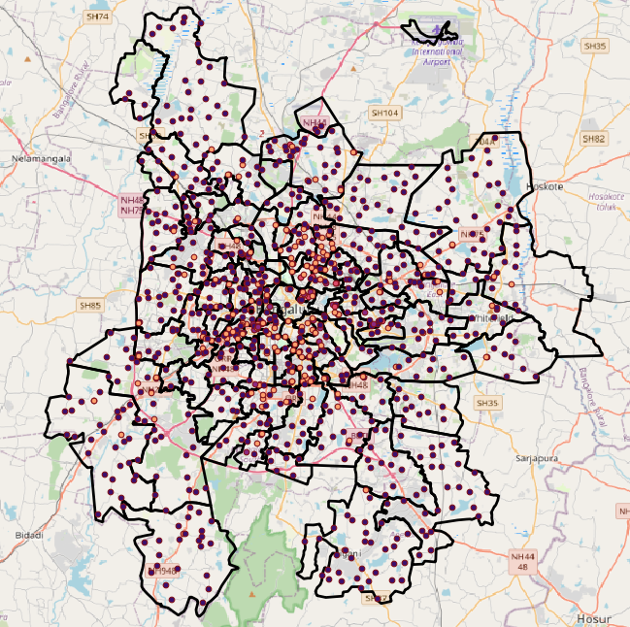
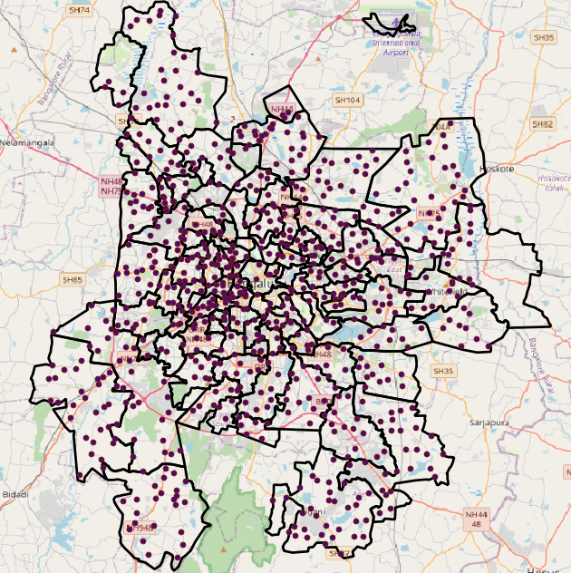
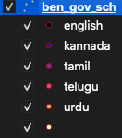
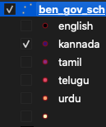
Categorize the medium of inculcation and select only the Kannada medium schools.

Slide 10
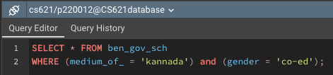
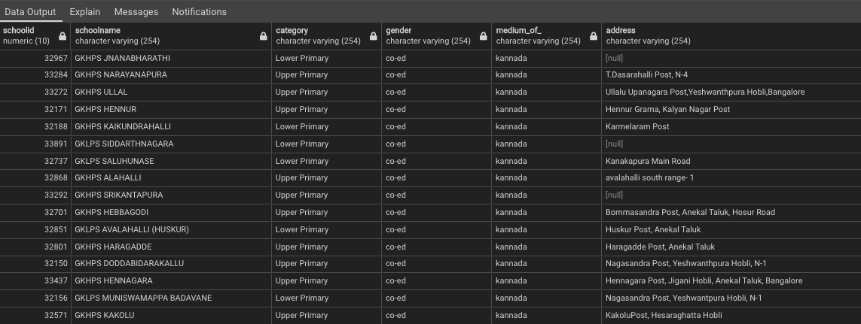
2. Filter the schools which have co-education.

Slide 11
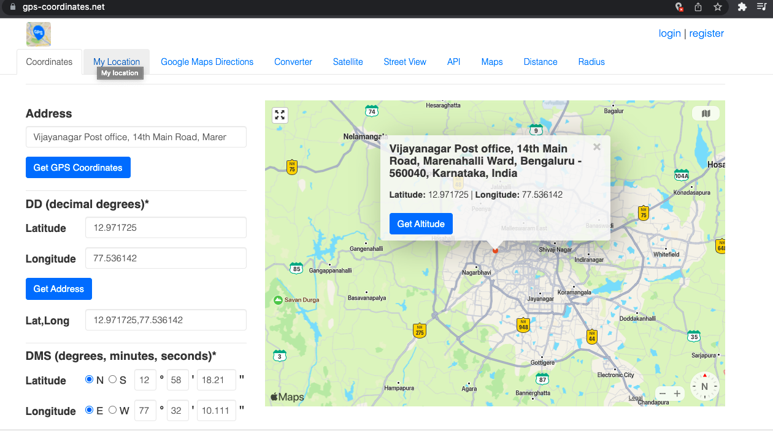
3. Get the WKT points from the provided residence address.

Slide 12
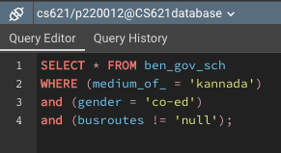
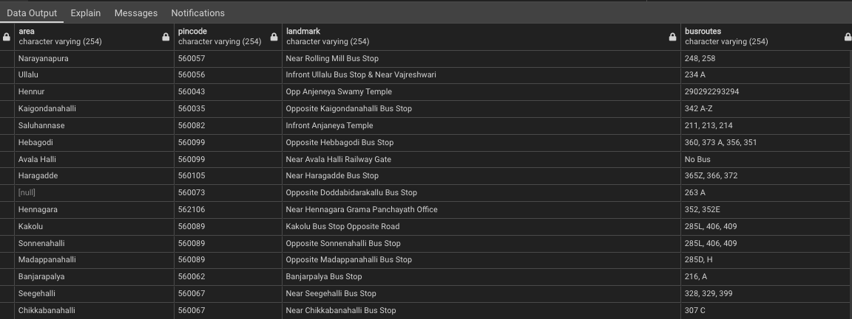
4. Select the school which has convenient bus facilities.

Slide 13
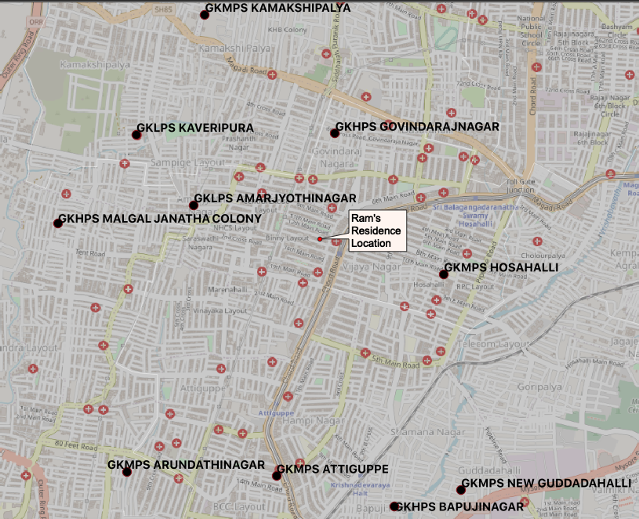
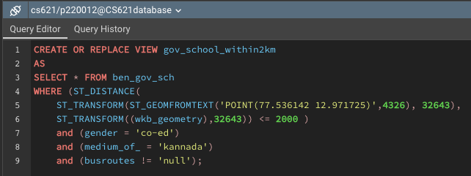
5. Select the schools which are within a 2 km radius proximate to Ram’s residence.

Slide 14
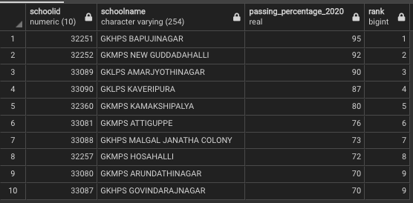
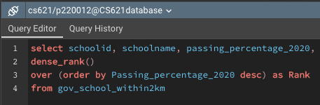
6. Finally, select the school which has more passing percentage.

Slide 15
Result
Upon analyzing the data with Ram’s criteria he can admit his son to GKHPS Bapujinagar.
School ID : 32251
School Name : GKHPS Bapujinagar
Address : 3rd Main Road, 7th Cross, Mysore Road, Bangalore.
Medium of Inculcation : Kannada
Type : Co-education
Bus Numbers : 222, 223, 224, 225, 226
Passing Percentage : 95%

Slide 16
Thank you…!

